Slide 1
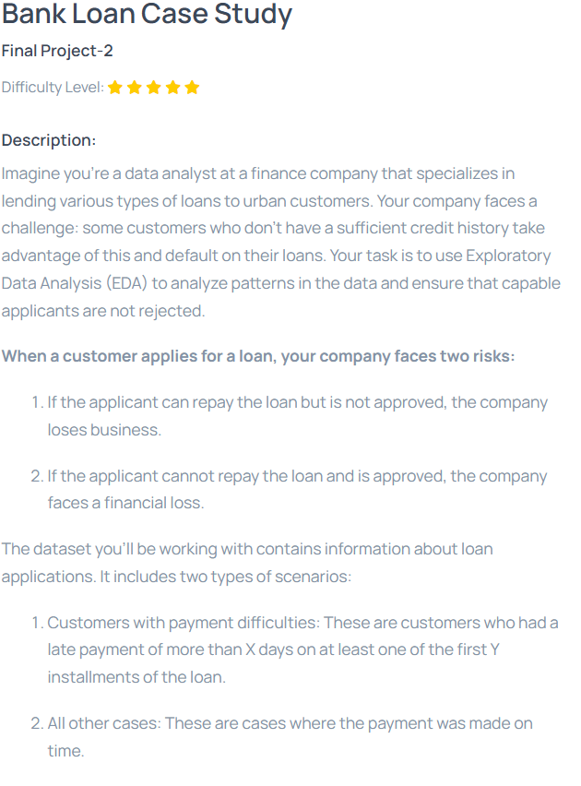
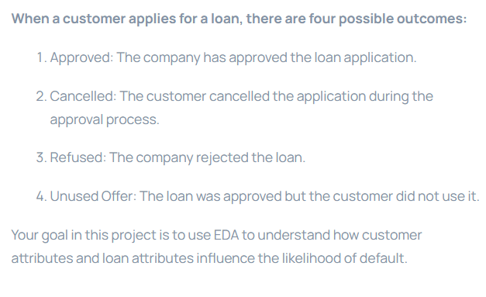

Slide 2
Report: Bank Loan Case Study
1. Project Description
Objective: The goal of this project is to perform Exploratory Data Analysis (EDA) on the loan application data to identify patterns that can help in making informed loan approval decisions. The project focuses on analyzing loan defaults, identifying outliers, handling missing data, and understanding key factors influencing loan repayment behavior.
Dataset: The analysis is performed using three datasets:
1. application_data.csv: Current loan applications data.
2. previous_application.csv: Information about previous loan applications.
3. columns_description.csv: A file containing explanations of the columns in the above datasets.
Main tasks:
1. Handling missing data.
2. Identifying outliers.
3. Analyzing class imbalance in the target variable (loan default).
4. Performing univariate, segmented univariate, and bivariate analysis.
5. Finding top correlations with the target variable (loan default).

Slide 3
2. Approach
1. Data Loading and Cleaning:
Imported the data files (application_data.csv, previous_application.csv) and explored the structure and details.
Identified missing data and handled it by imputing missing values with appropriate techniques (e.g., median for numerical data, mode for categorical data).
2. Outlier Detection:
Used the Interquartile Range (IQR) method to detect and visualize outliers in numerical columns.
Created box plots to visually highlight extreme values in each variable.
3. Class Imbalance Analysis:
Analyzed the target variable (TARGET) to check for data imbalance (whether loan defaults were significantly under/overrepresented).
Used bar charts to visually compare the distribution of classes.

Slide 4
4. Univariate, Segmented Univariate, and Bivariate Analysis:
Conducted univariate analysis on key variables such as AMT_INCOME_TOTAL to understand their distribution.
Performed segmented univariate analysis by splitting the data based on the target variable (TARGET), comparing defaulting and non-defaulting clients.
Bivariate analysis explored relationships between variables like AMT_CREDIT and AMT_INCOME_TOTAL, segmented by the target variable.
5. Correlation Analysis:
Calculated correlations between various features and the target variable to identify key factors influencing loan defaults.
Visualized correlations using heatmaps and extracted the top 10 most correlated features.

Slide 5
3. Tech-Stack Used
Python (Version 3.x):
Pandas: For data manipulation, handling missing values, and general data operations.
Matplotlib & Seaborn: For visualizing data distributions, outliers, and correlations using plots such as histograms, box plots, and heatmaps.
NumPy: Used for numerical operations.
Jupyter Notebook: Used as the IDE for coding, visualization, and documenting findings.

Slide 6
4. Insights
1 .Missing Data:
Several columns, especially financial metrics, had significant missing data. Imputation using median values for numerical columns provided a reasonable solution to preserve the dataset.
2. Outliers:
The AMT_INCOME_TOTAL and AMT_CREDIT columns exhibited several outliers, which may represent unusually large loans or extremely high incomes.
Outliers could skew analyses, and hence, they were visualized to decide whether to exclude them or treat them as extreme cases.
3. Data Imbalance:
There was a noticeable imbalance in the TARGET variable, with far fewer clients having loan repayment difficulties (TARGET=1).
This could indicate a need for resampling techniques in future predictive models (e.g., SMOTE) to ensure better prediction of defaults.
4. Key Correlations:
DAYS_EMPLOYED (employment duration) and EXT_SOURCE_2 (external rating) showed strong correlations with the target variable, suggesting that longer employment history and better external scores are good indicators of loan repayment reliability.
AMT_CREDIT and AMT_GOODS_PRICE also had moderate correlations with loan default, indicating higher credit amounts may have a connection to repayment difficulties.

Slide 7
5. Result
Improved Understanding of Loan Default: The analysis provided insights into the factors most strongly associated with loan defaults, particularly highlighting the role of income, credit amount, employment duration, and external risk scores.
Data Cleansing Strategy: The project highlighted the importance of handling missing data carefully and showed that a significant portion of the dataset could be salvaged through imputation.
Outlier Analysis: The detection of outliers was crucial in understanding extremes in the data, and further investigation could help determine whether these outliers represent valid cases or errors.
Correlation Insights: Identified top correlations between variables like DAYS_EMPLOYED, EXT_SOURCE_2, and loan defaults, offering guidance for future predictive models.
Video link :link

Slide 8
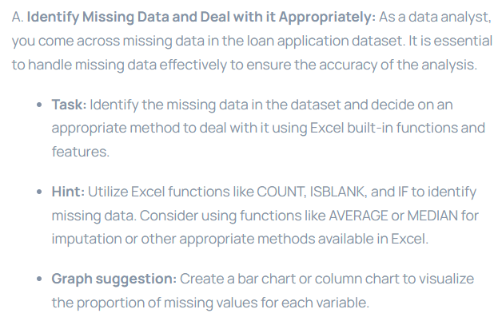
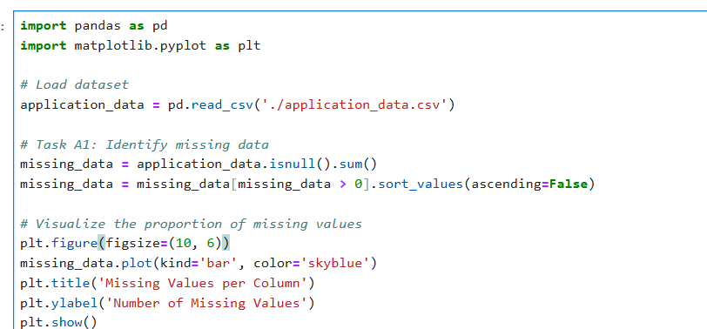

Slide 9
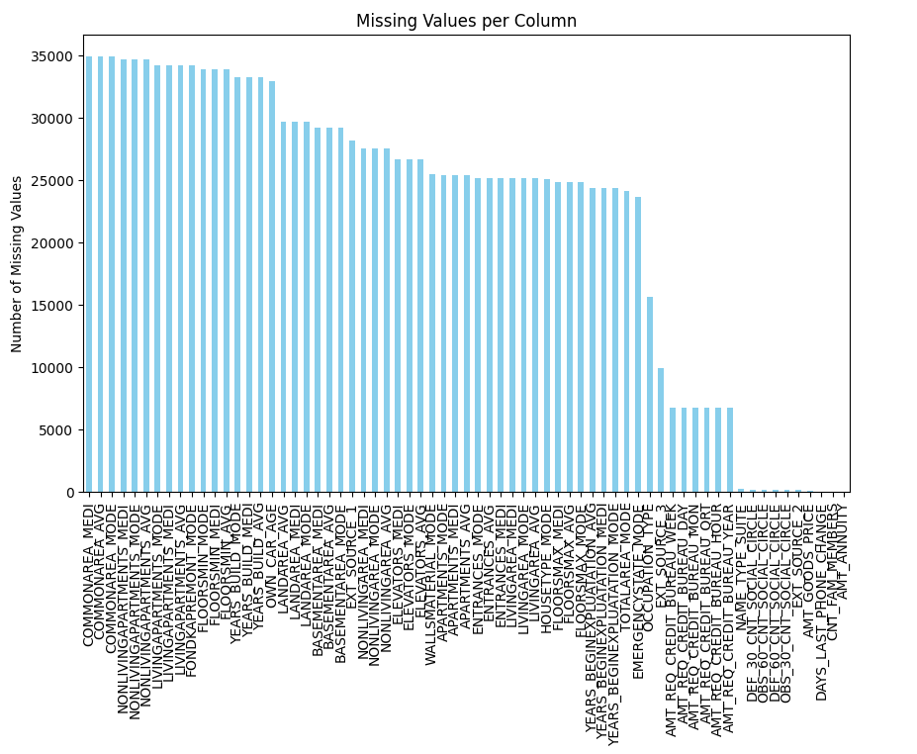

Slide 10
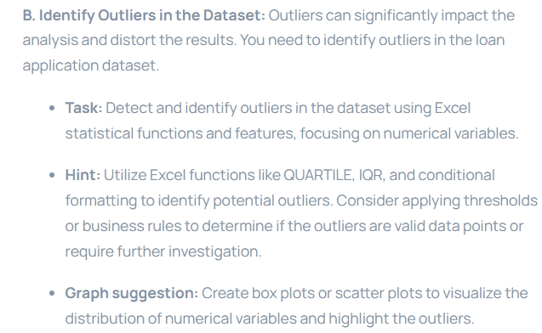
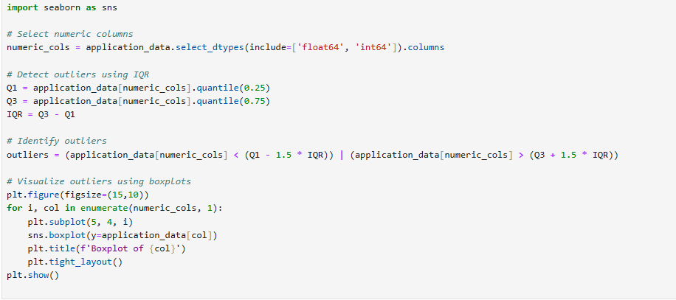

Slide 11
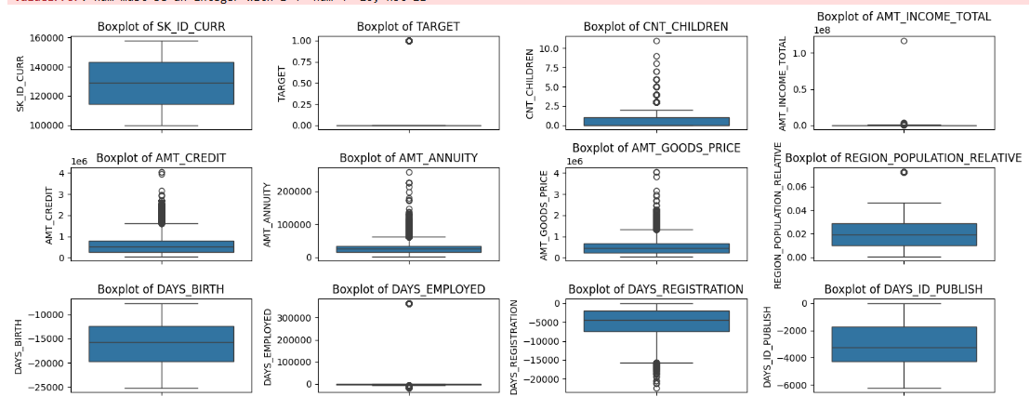

Slide 12
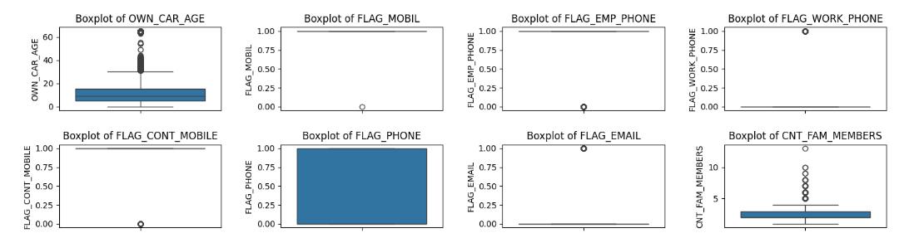

Slide 13
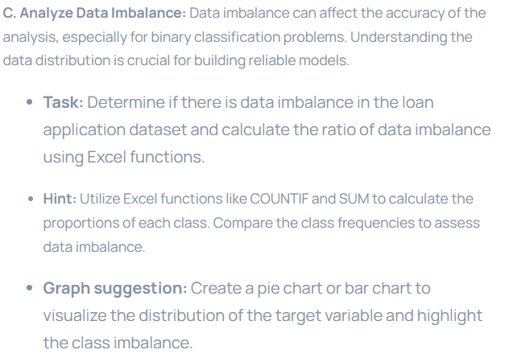
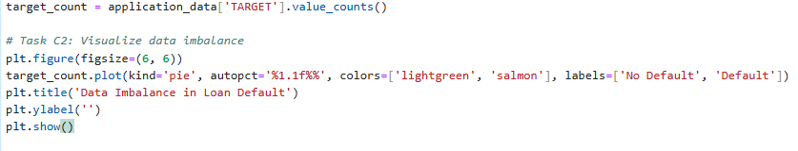

Slide 14
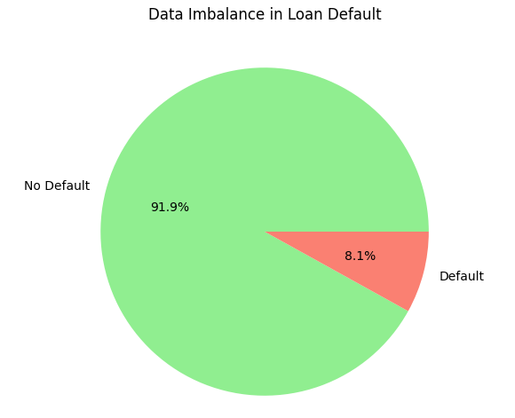

Slide 15
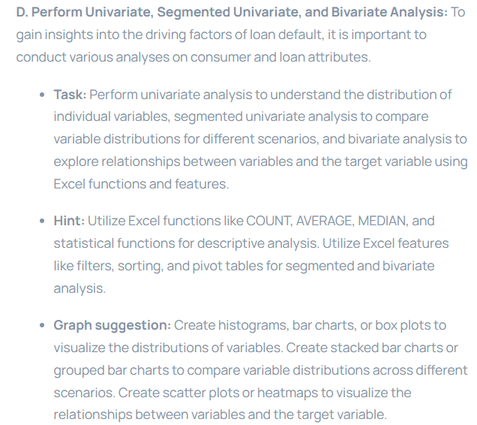
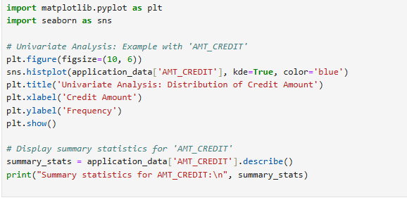

Slide 16
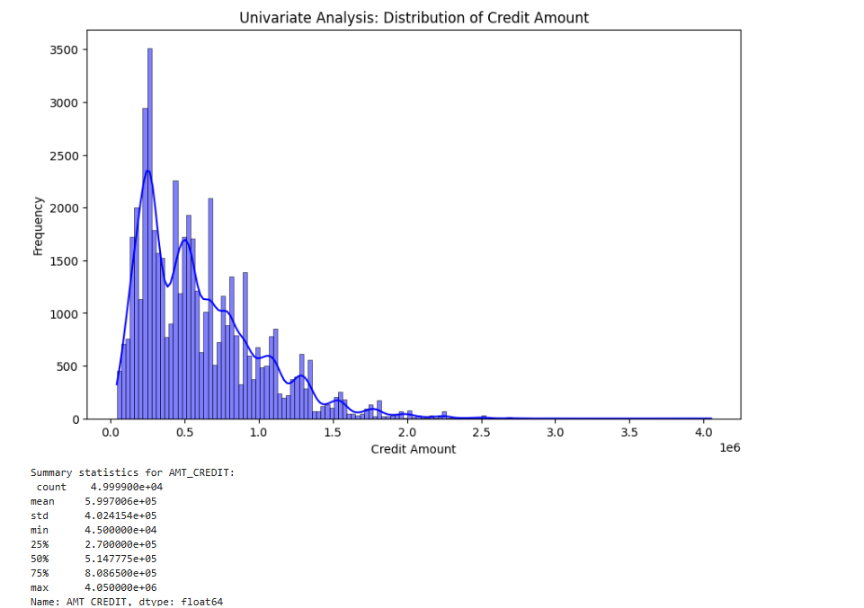

Slide 17
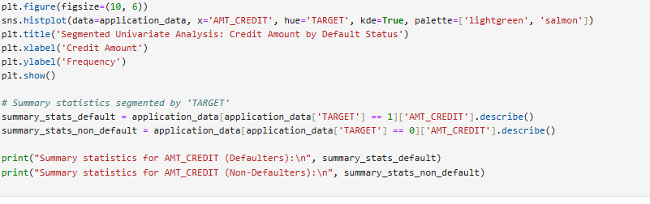
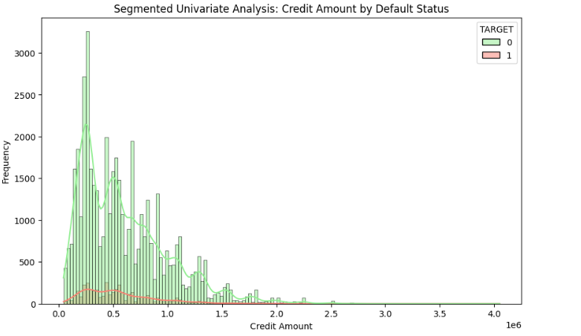
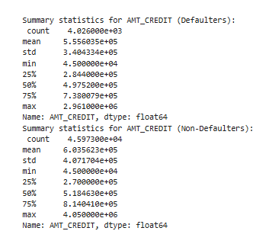

Slide 18
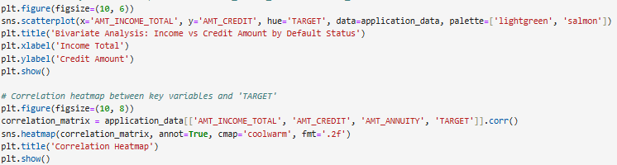
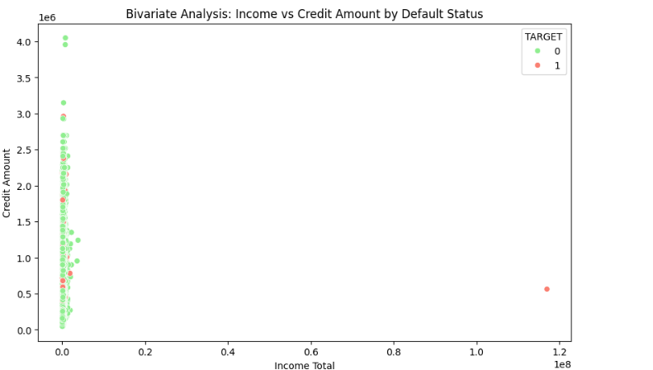

Slide 19
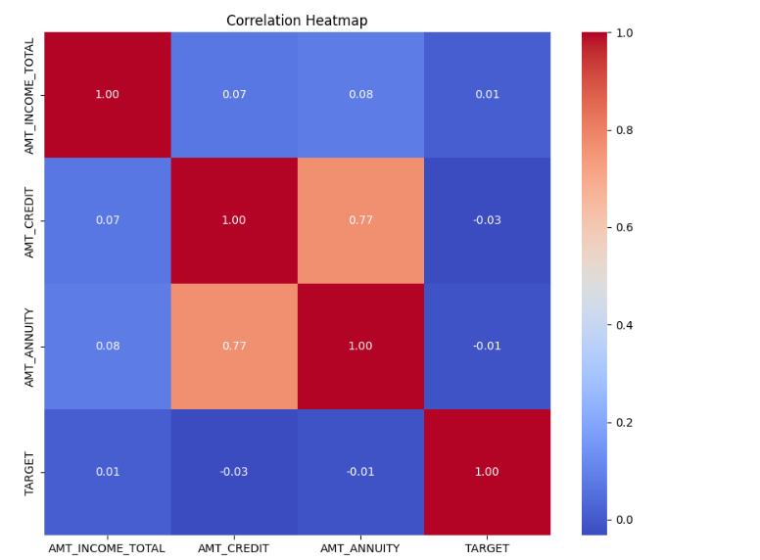

Slide 20
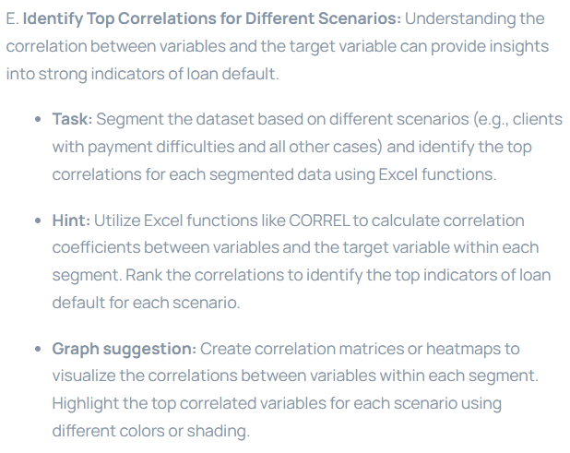

Slide 21

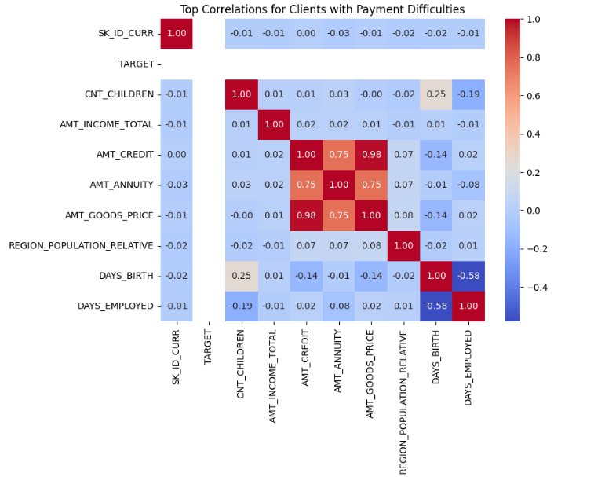

Slide 22

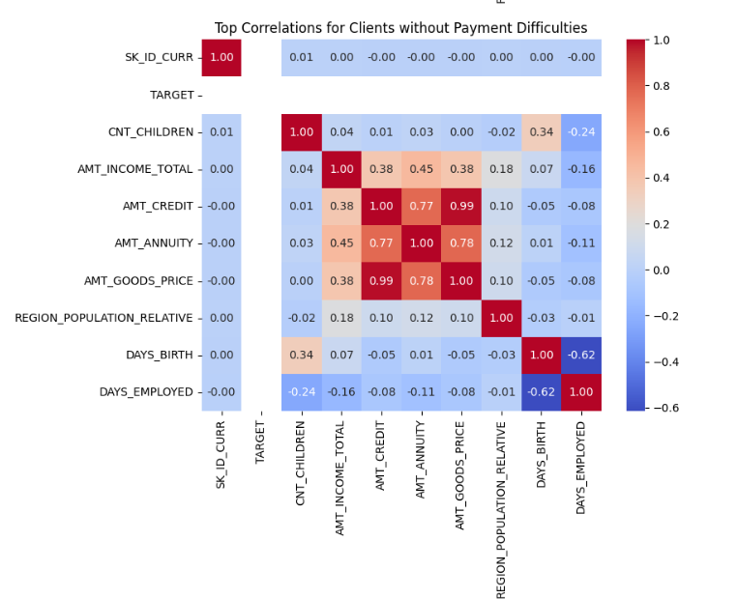

Slide 23
Thank You !

